Slide 1
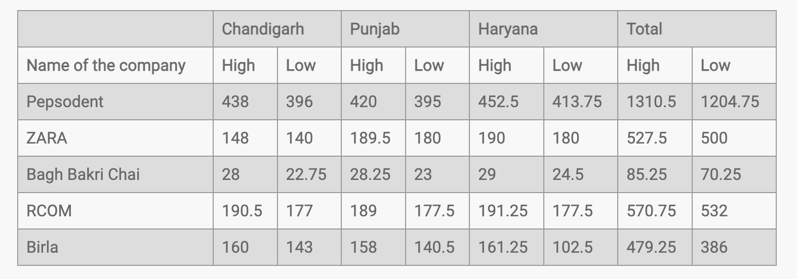
DIRECTIONS for questions 1 to 5: Read the table given below and answer the questions accordingly.
Q1. Avg high rates of Chandigarh?
A) Rs.192.9 B) Rs.202.9 C) Rs.169.9 D) Rs.178
Q2. Punjab low total exceeds Haryana by?
A) 17.75 B) 15.67 C) 15.57 D) None
Q3. RCOM low as % of ZARA low?
A) 98.4% B) 101% C) 106.4% D) None
Q4. Chandigarh high for Birla as % of Punjab + Haryana high?
A) 50% B) 44% C) 40% D) 55%
Q5. Total highs exceed total lows by?
A) 260 B) 170 C) 270 D) 280.25

Slide 2
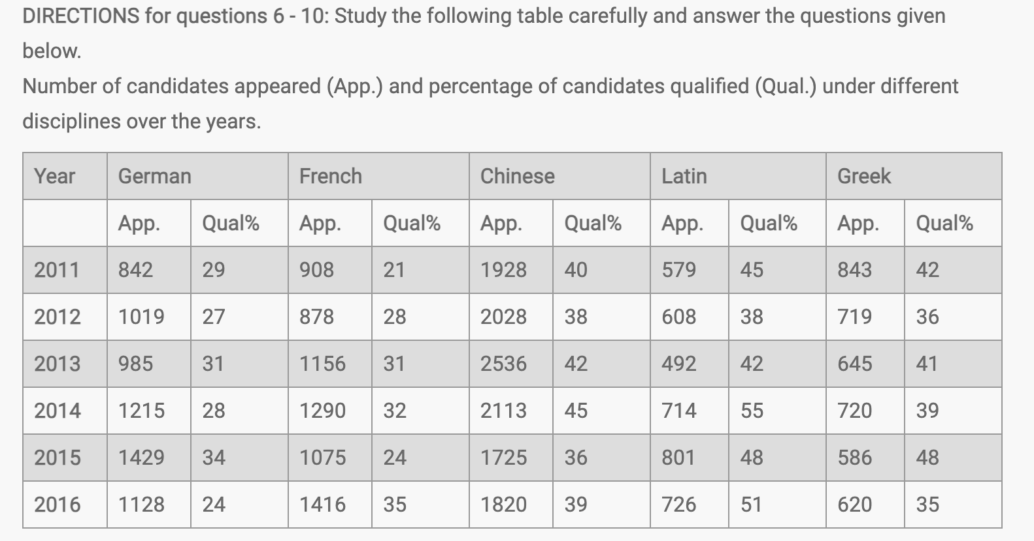
Q6. Approx. percentage increase in German candidates from 2013 to 2014? A) 230 B) 23 C) 40 D) 30
Q7. How many students qualified for Chinese stream in 2014? A) 450 B) 950 C) 650 D) 900
Q9. Students qualified in 2011 under Greek and French combined were? A) 505 B) 545 C) 530 D) 560
Q10. Which pair of years in German totals the Chinese appeared candidates in 2014? A) 2016,2015 B) 2013,2016 C) 2016,2014 D) 2016,2012
Q8. Which 2 years had approximately same qualified students in Greek stream? A) 2013,2014 B) 2014,2015 C) 2012,2013 D) 2011,2016

Slide 3
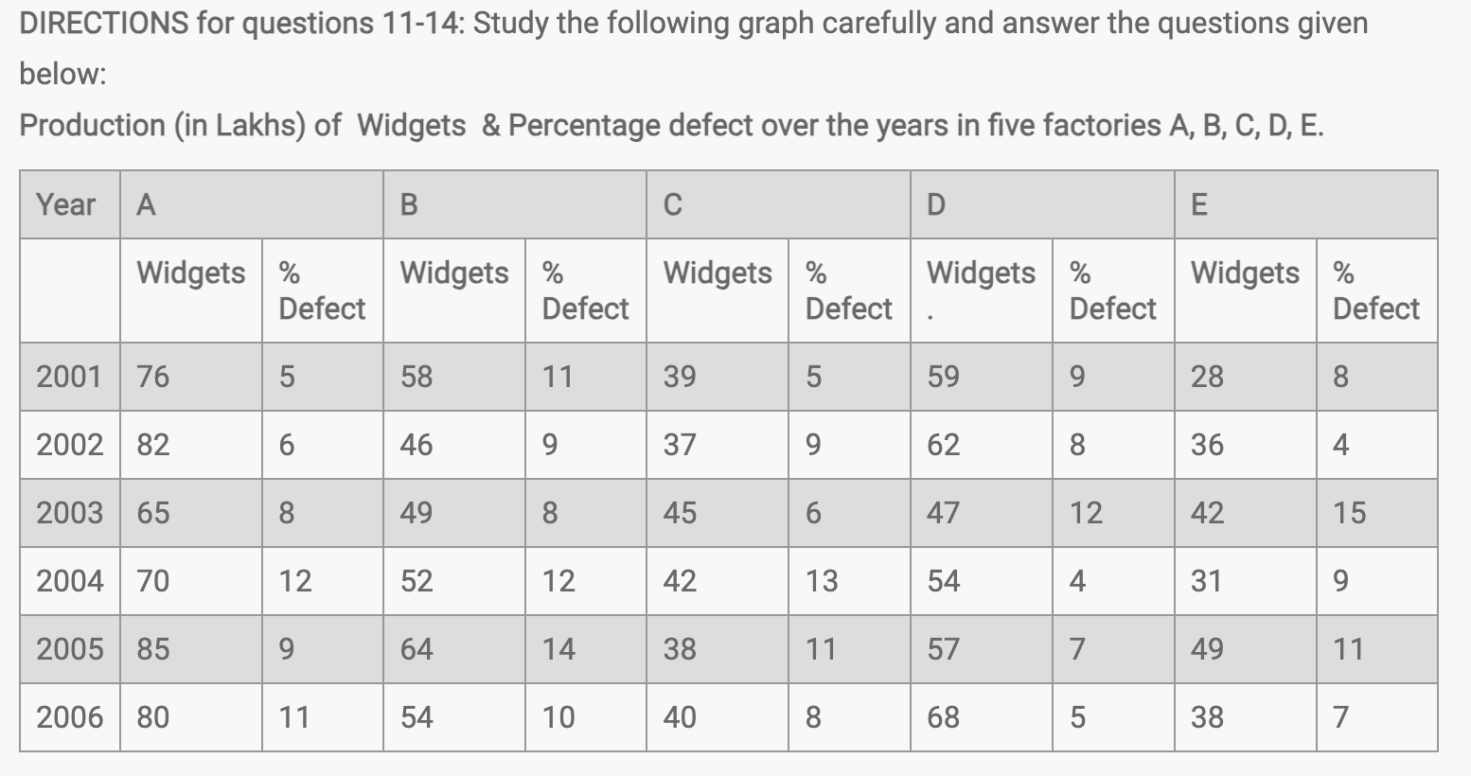
Q11. The average production for the given data will be maximum for which factory?
A) B B) E C) A D) D
Q12. Difference in defected widgets of Factory C (2006) and Factory E (2003)?
A) 2800 B) 4000 C) 3500 D) 3100
Q13. Average widgets produced in 2002 formed what percent of widgets produced in 2006?
A) 94% B) 90% C) 85% D) 99%
Q14. Difference in defect-free widgets of Factory C in years 2004 and 2006?
A) 300 B) 150 C) 260 D) 400

